Slide 2
System Center Configuration Manager v.Next: Application Management
Mark Florida, Principal Program Manager Lead
Wally Mead, Senior Program Manager
Microsoft Corporation

Slide 3
Agenda for Today’s Session
Overview of Software Distribution (SWD) in Configuration Manager v.Next
Create, deploy and monitor applications
User Device Affinity
Simple apps with more complex rules
Deployment types in detail
Advanced applications – tying it together with multiple deployment types
Revision Management
Content, Applications and OSD

Slide 4



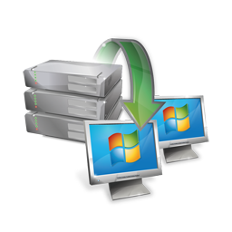



Pillars of the Release
Embrace user-centric management
Provide a rich application management model to capture admin intent
Allow the administrator to think users first
Provide the end user a fitting user experience to find/install software with
Allow the user to define their relationship to applications
Modernize our infrastructure and core components
Redesigned hierarchy and SQL Server replication
Automated content distribution
Client Health improvements and auto-remediation
Redesigned admin experience and role-based security model
Native 64-bit and full Unicode support
Continue to improve throughout the product
Software Updates auto-deployment (including Forefront definitions)
Automated settings remediation (DCM “set”)
Consolidated and expanded mobile device management
Improvements to Operating System Deployment and Remote Control
And much, much more…

Slide 5
New Features for Software Distribution v.Next
Application Model
Incorporates all supported software types (MSI, Script, App-V, Mobile CAB)
Greatly improved dependency handling
Installation requirement rules
User Device Affinity
Unified deployment process
Unified monitoring experience
End user experience
Software Catalog
Software Center
Content management
State based distribution point groups
Single instance content store

Slide 6
ConfigMgr 2007 to ConfigMgr v.Next Comparison – Application Model
Configuration Manager 2007 | Configuration Manager v.Next
Package | Application and Deployment Types
Program
Advertisement (install status) | Deployment (state based) via detection method
Collection rules (server) | Requirement rules (client)
None | User Device Affinity
Run Advertised Programs | Software Center
None | Software Catalog
None | Single Instance Content Management

Slide 7





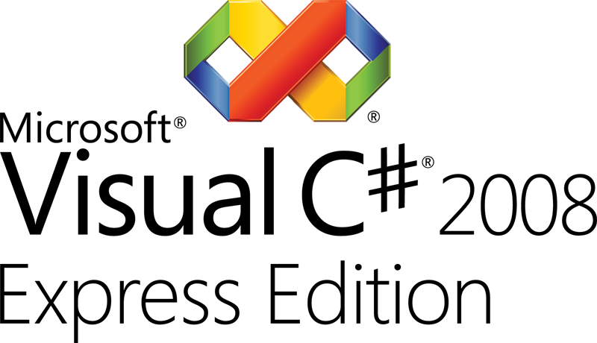
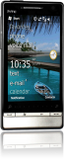
Application Model Diagram
Application
Administrator Properties
General information about the software application
Keep your apps organized and managed
End User Metadata
The “friendly” information for your users
App-V
Windows
Script
Windows
Installer (MSI)
Mobile (CAB)
Deployment Type
Workhorse for application
Requirement Rules
Can/cannot install app
Dependencies
Apps that must be present
Detection Method
Is app already installed?
Install Command
Command line and options
Content
Source files for the app

Slide 8
Application and Deployment Types
Application is the core information shared by all Deployment Types
Application Name, Manufacturer, Version etc.
App is the deployed or targeted object
Information the admin wishes to share with users in the Catalog
All relationships to all or any of the deployment types in this application
Deployment Type is the basic building block for an Application and represents an installer or delivery method
Similar to packages and programs in Configuration Manager 2007
Contains the install commands, pre-requisite checks, detection methods, etc.

Slide 9
Deployment Type
Contains the following types of attributes:
Requirement Rules
Need to be “true” in order for the deployment type to install on a given client
Dependencies
Additional deployment types this deployment type requires, Installed if admin decides
Detection Method
A way to identify the application on the device
Installation Method
Install program, content, etc.
Content
Where the files are located
Can be one of many types
MSI, App-V, Script, Mobile CAB, Citrix XenApp, RDS etc…

Slide 10
Deployment
Replaces “Advertisement” from Configuration Manager 2007
Created when an Application is deployed to a Collection
Due to applications being state based, only deploy to a collection once
2 types of deployment purposes
Required (like ‘mandatory’ in Configuration Manager 2007)
Available (like ‘optional’ in Configuration Manager 2007)
Available for User targeted displayed in Software Catalog
Available for Device targeted displayed in Software Center on client
Provides setting for “Pre-deployment” feature when targeting user or user security group collections

Slide 11
Creating applications
demo

Slide 12
Dependencies
Other deployment types that must be present in order for the current application deployment type to be installed
1 to n dependencies
This AND this AND this OR this
.NET Framework either 3.5 or 4.0 and
Browser either IE7 or IE8, install IE8 if none present
Dependencies are modeled as applications and can also be deployed independently

Slide 13
Introducing Detection Methods
Detection methods enable systems to determine whether or not an application is already present on a system (discovery)
In the Software Updates world, this is known as IsInstalled
Many system attributes play into presence of an application on a system (registry, file versions, MSI database, WMI, etc)
Detection is the key to any state based software distribution system

Slide 14
Detection Methods
In ConfigMgr v.Next Beta 1, available detection methods are:
MSI Product Code or Script detection for exe or MSI-based installers
App-V and Mobile CAB – built-in
In Beta 2, possibly additional detection method options for MSI/Script deployment types
Registry
File
WMI

Slide 15
Global Conditions in ConfigMgr v.Next
Foundation of conditional delivery rules
Properties of users and/or devices that make delivering software appropriate
Global conditions are system artifacts
Global condition = Machine is Laptop
“Machine is Laptop” maps to a system attribute (WMI class property for example)

Slide 16
Global Conditions and Requirement Rules
If Laptop = True
Machine is Laptop
Machine is a laptop if the WMI property Win32_SystemEnclosure.SystemChassis is 8 (Portable), 9 (Laptop), or 10 (Notebook)
Requirement Rule
Global Condition
System Attribute

Slide 17
Global Conditions – Out of the box
Type | Global Condition Name
Machine | Machine AD Site CPU speed Mobile device type Free disk space (system, admin defined partitions or any) Total Physical Memory (also Free Phone Memory) Mobile input type Machine AD Organizational Unit (OU) Number of processors Machine Operating System and Architecture (also mobile) Machine Operating System Language (also mobile) Screen resolution ConfigMgr Assigned Site
User | Primary Device
Custom | Create new Simple conditions Complex conditions (expressions)

Slide 18
Global Expressions
Enables the application author or admin to create logical groupings of global conditions and assign values
These expressions can be reused for applications
Example:
“Standard Company Desktop”
Memory = 1 GB
and Free Disk Space = 500 MB
and System Manufacturer = American Megatrends Inc.
and Operating System = Windows 7

Slide 19
Software Catalog – User Targeted Available Software (Applications and Packages)
Browse and search for software
Fully localized for site and applications
Search via category or name
Install software
Direct self-installation from software catalog
Leverages full infrastructure for content and status
Automatic installation upon approval
Request applications
Request approval for software
View request history

Slide 20


Software Catalog – Details
Server Requirements
Two site roles
Windows Server 2008 64-bit and IIS 7.0
Client Requirements
Configuration Manager v.Next client
IE 7.0 / 8.0
Silverlight 3.0 (auto-installed on clients)
Extensibility: Software catalog web service point
Can be used by:
3rd party client application
3rd party web site
Connections via ASP.NET

Slide 21
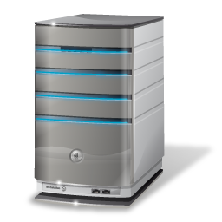


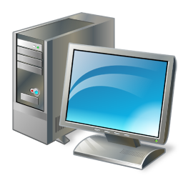


On Demand Installation
Process Flow
Web Site
Site Server
User clicks “Install” on catalog item
Web site checks user’s permissions to install
Web site requests client ID from ConfigMgr client agent and passes it to site server
Server creates policy for the specified client and app and passes it to client
Client agent evaluates requirements from the policy and initiates installation
Client agent completes installation process and reports status
Melissa
Agent

Slide 22
Applications, rules and dependencies
demo

Slide 23






Application Evaluation Flow
New Policy App Install Schedule
Requirements met?
No
Yes
Is installed?
Yes
No
Dependencies installed?
No
Install dependencies
Yes
Install Application
Dependencies installed

Slide 24
What is User Device Affinity?
Is the key to helping our customers move to User Centric software distribution
Provides the ability to define a relationship between a user and a device
Allows the admin to think “user first”, while also ensuring the application is not installed everywhere the user logs on
Configuration Manager v.Next supports:
Single primary user to single primary device
Multiple primary devices per user
Multiple primary users per device
The system allows both the administrator and user to define this relationship

Slide 25
Benefits of User Device Affinity
Allows the deployment of software based on the nature of the relationship between the user and device
For example:
Install the MSI or App-V version of Microsoft Office when the device is a primary device of the user targeted; install the Terminal Server version if the device is not a primary device
Only install the App-V version of Microsoft Visio if the device is a primary device of the targeted user, otherwise don’t install
Eliminates the problem of users leaving software everywhere they log in
Enables Pre-Deployment of Software
Allows software to be pre-deployed on a user’s primary devices whether or not the user is logged in

Slide 26
How Can User Device Affinity be set?
User device affinity relationships are defined:
Based on a usage threshold on client
Using import file from external source
As part of Operating System Deployment
During Mobile Device enrollment
By end-user through Software Catalog
Manually by administrator
Client Agent Settings
Define user device affinity configuration at collection level
Usage and User based user device affinity can be enabled and configured using Client Agent Settings

Slide 27
Application Model Diagram
Application
Metadata
Global Conditions
Properties
Requirements
Custom Conditions
Deployment Type
Content
Detection
Install Command
Application
Dependencies
…
Deployment Type
Deployment Type
Requirements
Content

Slide 28
Evaluation Based on Deployment Purpose
Required deployments
At activation, Configuration Manager client will
Evaluate and download
At deadline, Configuration Manager client will
Evaluate, download (if necessary), and install all in one action
Available deployments
User-Initiated and the Configuration Manager client will
Evaluate, download and install all in one action

Slide 29
Custom conditions and expressions
demo

Slide 30
App-V in ConfigMgr v.Next: What’s changing?
Integration requires App-V 4.6 client
New application model, user-centric features
Enable support for application dependencies
Improved update behaviors
Selective publishing of components
Dynamic Suite Support
Instant icon gratification for unlock events
Integration with Remote Desktop Services (TS)
Content Improvements
Streaming improvements
Reduce virtual app footprint when using Download and Execute

Slide 31
Benefits of Multiple Deployment Types
Flexible way to deliver different installation formats based on conditions
No restrictions on the number and types of deployment types
Five of the same type of deployment types could be added to an application each representing a different command line or transform
App-V or Remote Desktop Services application might go to a guest logged into a kiosk, full MSI to a user’s primary desktop machine

Slide 32
Application Management
Retiring an application when it is decommissioned
Existing deployments continue to work
No new deployments can be created
An application can come out of retirement by reactivating it
Revision history
View revision history of an application object
Delete revisions
Revert back to a previous revision
Applications and all of their contents, dependencies can be exported and imported from the Configuration Manager v.Next console

Slide 33
Applications and Task Sequences
Use Applications for complex software installation in place of the task sequence
Applications are optimized for user targeting, task sequences are still machine based
Optimized for conditional delivery, dependencies and version management
Not preventing the use of task sequence, however Application will cover almost all scenarios! ☺

Slide 34
Applications and Task Sequences (2)
Application guidance for operating system deployment
“Install Application” is an integrated task sequence action
Application will evaluate at run time during the task sequence
Assesses applicability for deployment type based on rules and processes the dependencies at run time
Operating system deployment process guidance
Only install Applications that require state restore (USMT Settings) as part of a task sequence
User device affinity/pre-deploy will complete the install of user targeted applications immediately after the task sequence completes

Slide 35
Content Distribution
Distribution Point Groups
Improved functionality and workflow
Can be linked to Collections for workflow optimization
Automatic distribution of content for added distribution points
Single Instance Storage
Files will be stored once, even if they are used across multiple applications
Bandwidth Control
Customize time and bandwidth utilization on distribution points

Slide 36
Content Distribution (2)
Enhanced views for content that has been distributed
From a distribution point or group
The ability to view deployed content status
From application, package, etc
The ability to see the distribution points or groups

Slide 37
Distribution points, groups, and content
demo

Slide 38

© 2010 Microsoft Corporation. All rights reserved. Microsoft, Windows, Windows Vista and other product names are or may be registered trademarks and/or trademarks in the U.S. and/or other countries.
The information herein is for informational purposes only and represents the current view of Microsoft Corporation as of the date of this presentation. Because Microsoft must respond to changing market conditions, it should not be interpreted to be a commitment on the part of Microsoft, and Microsoft cannot guarantee the accuracy of any information provided after the date of this presentation. MICROSOFT MAKES NO WARRANTIES, EXPRESS, IMPLIED OR STATUTORY, AS TO THE INFORMATION IN THIS PRESENTATION.

